Slide 1
TRAINING MANUAL
FOR
ELECTORAL REGISTRATION OFFICERS (EROs & AEROs)
[PPT]
Disclaimer:
This training material is for use in training of election officials. It should not be referred as guidelines of ECI. In case of any variance in this training material and ECI guidelines/ rules/ laws, the ECI guidelines/ rules/ laws shall prevail.
Published in August, 2014 from
The India International Institute of Democracy and Election Management (IIIDEM)
Election Commission of India, New Delhi
e

Slide 2
In the earlier PPTs , we have discussed
  Legal & Structural Matters
  Procedural Matters
  Inclusion and Facilitation
  Map-making, House-numbering
  Forms and their Mock Filling
  Receipt & Disposal of Claims & Objections
  Verification of E-Rolls
  Service Voters, Overseas Electors etc.
  Computerization of E-Rolls & ERMS

Slide 3
In this PPT, we will discuss
  Motivation
  The Importance of Electoral Roll and its Accuracy
  The Importance of Summary Revision as an Opportunity for Improving the Quality & Accuracy of Rolls
  The Importance of EROs & AEROs
  Importance of Procedural and Legal Discipline
  Health Analysis of E-Roll
  De-Duplication
  Error/Problem Identification
  Formulating Points of Strategy & Plan of Action
  How to Train the BLOs
  Case Studies, FAQs
  End of Training Evaluation

Slide 4
MOTIVATION

Slide 5
“Quality is not an act, it is a habit.”
- Aristotle

Slide 6
CONNECTING &
SHARING
A spool (or reel) of string or wool for is needed for this game. Ask the trainees to stand in a circle. (If a spool is not possible, then numbered chits could be given). Hold on to the end of the string and throw the ball/spool to one of the trainees to catch. That person then narrates one of his/her field experiences/challenges related to E-Rolls (or any other election process) and how s/he overcame it.
Holding a part of the string, each participant then throws the spool to another member of the group one after another.
Eventually this creates a web of the string, as well as a connectedness based on sharing of experiences and knowledge.

Slide 7
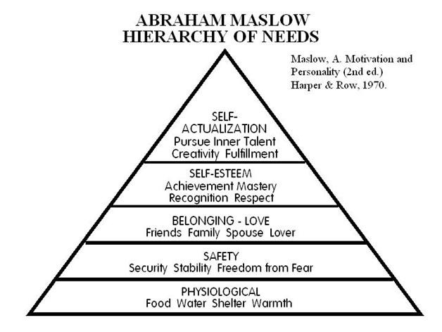
Ask about human needs. Then by displaying Maslow’s pyramid, discuss and explain how the EROs and AEROs can achieve greater self-fulfilment by working for the higher social and national cause of ensuring free and fair elections through proper maintenance of electoral rolls.
WHY SHOULD WE WORK FOR DEMOCRACY?

Slide 8
IMPORTANCE
OF MATTERS

Slide 9
The IMPORTANCE of
The ELECTORAL ROLL

Slide 10
IMPORTANCE of
The ELECTORAL ROLL
An electoral roll or voter list is an official list of persons enrolled as voters on the basis of their eligibility for such enrolment in the list of a particular area. It determines who is eligible to vote and where.
For a free and fair election, an accurate and error free electoral roll is of utmost importance.
A good e-roll is required for checking electoral malpractices like bogus voting and impersonation.
According to Article 325 of the Constitution of India, there shall be one general electoral roll for every territorial constituency for election to either House of Parliament or to the House or either House of Legislature of a State and no person shall be ineligible for inclusion in any such roll or claim to be included in any special electoral roll for any such constituency on grounds only of religion, race, caste, sex or any of them.

Slide 11
The IMPORTANCE of
QUALITY & ACCURACY of the ELECTORAL ROLL

Slide 12
IMPORTANCE of
QUALITY & ACCURACY of the ELECTORAL ROLL (1)
Accuracy and Completeness of Rolls is essential for conducting free and fair elections.
  An accurate and good quality roll is the first necessary step towards preventing electoral frauds & malpractices.
  In situations of tough electoral competition and narrow lead margins, the need to have accurate electoral rolls becomes all the more critical.
Take care - Some people may want large scale registration of bogus voters, or large-scale deletion of names of “unfriendly” voters.

Slide 13
IMPORTANCE of
QUALITY & ACCURACY of the ELECTORAL ROLL (2)
B. Correct entry in the roll entitles people to vote and assures them their right of franchise.
      It provides to a citizen,
          the fundamental sense of belonging to his nation, his state and his constituency,
          connects him to them – politically and by duty and responsibility, and
          gives him an identity and an identification in the records of the state – something of immense value and direct utility to him.
      Hence, correct entry in the roll is important for every individual voter.
As such, in the E-Roll there should not be any name unduly missing, unduly surplus (eg dead, shifted or fictitious) or duplicate. The roll should be error-free, clean & up-to-date.

Slide 14
The IMPORTANCE of
SUMMARY REVISION AS AN OPPORTUNITY
TO IMPROVE THE QUALITY & ACCURACY OF E-ROLL

Slide 15
IMPORTANCE OF
SUMMARY REVISION AS AN OPPORTUNITY
TO IMPROVE THE QUALITY & ACCURACY OF E-ROLL
Summary Revision is a Once-a-Year Opportunity.
SR entails a Targeted & Proactive approach towards
  Procedural Discipline: Receiving & disposing Claims & Objections in a decided time frame.
  Inclusion: Covering excluded sections of population, uncovered localities/colonies etc.
  Field Verification
Simultaneous Focus of DEO, ERO and their entire administrative machinery on SR leads to better outcomes.
Greater involvement of political actors and civil society (BLAs, RWAs etc.)
Time to cover the uncovered ground in advance with 1st January of the following year as the reference date.
With greater focus, stakeholder participation & coordinated action, Summary Revision is
a unique opportunity to improve the quality & accuracy of E-Rolls.

Slide 16
The IMPORTANCE of
EROs & AEROs

Slide 17
The IMPORTANCE of
EROs & AEROs (1)
EROs and AEROs are the Custodians of the Electoral Roll of an AC.
  Under Sec 13B of RP Act, 1950, the roll for each constituency is prepared and revised by the ERO. He plays a pivotal role in & is fully responsible for the preparation, maintenance and revision of roll for his constituency.
They draw out the plan of action for completion of revision according to the schedule by the Commission giving a detailed time line for completion of each activity within the different stages of revision. They train, supervise and monitor their BLOs, Designated Officers (DOs), Supervisors and act as the bridge between them and the Commission.

Slide 18
The IMPORTANCE of
EROs & AEROs (2)
They conduct the Pre-Revision Activities, like Rationalization of PSs, De-Duplication, Integration of Rolls etc.
They are In-charge of the publication of Draft Roll thereby making the entries in the roll available for inspection & display to all stakeholders.
They connect with all stakeholders. They convene meetings with representatives of political parties, Gram Sabhas, RWAs etc. so that they go through the published roll & point out any errors and problems in it. They are the ones who press the need for timely information and submission of claims of objections.
They issue notices and conduct enquiries into the claims & objections received.
Ensuring ACCURATE Inclusion & Deletion of names, as well as the correctness of all entries in the roll by following the due process, is their responsibility.
They are the ones who analyse the rolls & formulate and implement strategies to improve them.

Slide 19
The IMPORTANCE of
PROCEDURAL & LEGAL DISCIPLINE

Slide 20
The IMPORTANCE of
PROCEDURAL & LEGAL DISCIPLINE
Strictness with due processes for receipt and disposal of Claims & Objections, like issuing and serving notices, getting proper field enquiries or house visits conducted etc., is of utmost importance.
All Pre-Revision activities MUST be carried out on time and with full diligence and sincerity.
Health Analysis of Rolls, De-Duplication, Advance Error Identification MUST be seriously done, Strategy and Plan of Action prepared, and follow up action taken.
Utmost Care should be taken while taking decisions of Deletion, especially Suo-Motu Deletion.
Every order of EROs and AEROs MUST be a Speaking Order. It should contain not only facts, but also the reasons and the grounds for the decision contained in the order. Again, this is most required in cases of Deletion, esp. Suo Motu Deletion.
Proper Case Registers MUST be maintained for these (roll related) cases by EROs and AEROs. Remember, the decisions EROs and AEROs give in roll related cases are all Quasi-Judicial Decisions.

Slide 21
HEALTH ANALYSIS OF THE ROLL
BY THE ERO

Slide 22
HEALTH ANALYSIS of Rolls
To analyse the health of Electoral Rolls, the Election Commission has prescribed 8 Formats (attached in the slides hereafter) vide ECI Circular No. 23/2012/ERS (Vol III) dated 1-10-2012 with formats as follows:
Format 1- Gender Ratio
Format 2 – E P Ratio (MFT)
Format 3 - Age Cohort wise Elector Information
Format 4 – Information about Inclusion & Deletions in the Current Roll over Previous Roll
Format 5 – Photo & EPIC Coverage
Format 6 – PSL Details
Format 7 – Information about Service Voters
Format 8 – Information about Migrated Electors
EACH TRAINEE ERO/ AERO SHOULD DO ACTUAL ANALYSIS OF FORMATS 1 TO 8 FOR HIS AC DURING THE TRAINING ITSELF
FOR THIS, EACH TRAINEE ERO/ AERO SHOULD BRING FORMATS 1 TO 8 FOR THEIR ACs FILLED IN ADVANCE, TO THE TRAINING
CEOs & DEOs MUST ENSURE THIS

Slide 23
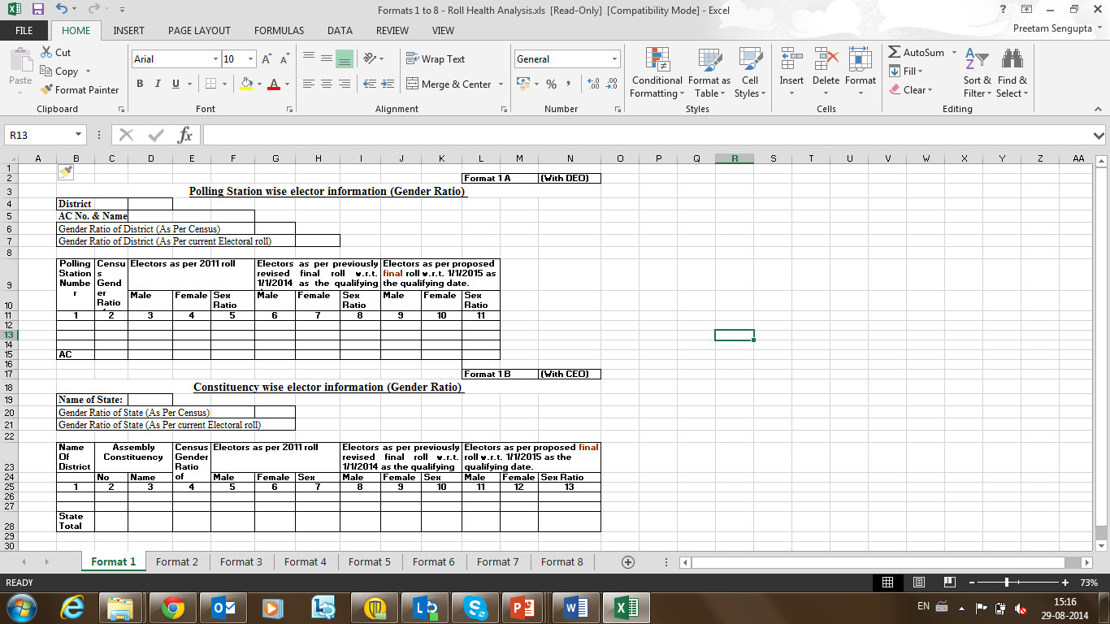
HEALTH
ANALYSIS
FORMAT 1
Gender Ratio

Slide 24
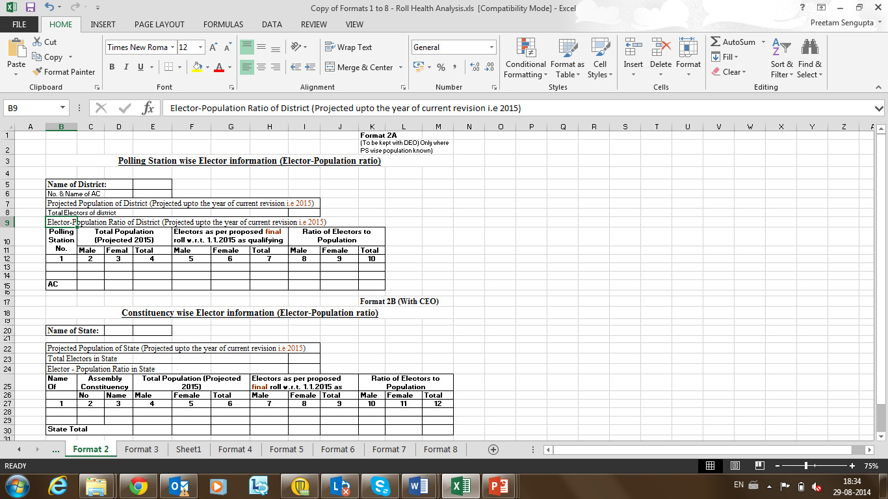
FORMAT 2
E P Ratio
(MFT)
HEALTH
ANALYSIS
HEALTH ANALYSIS

Slide 25
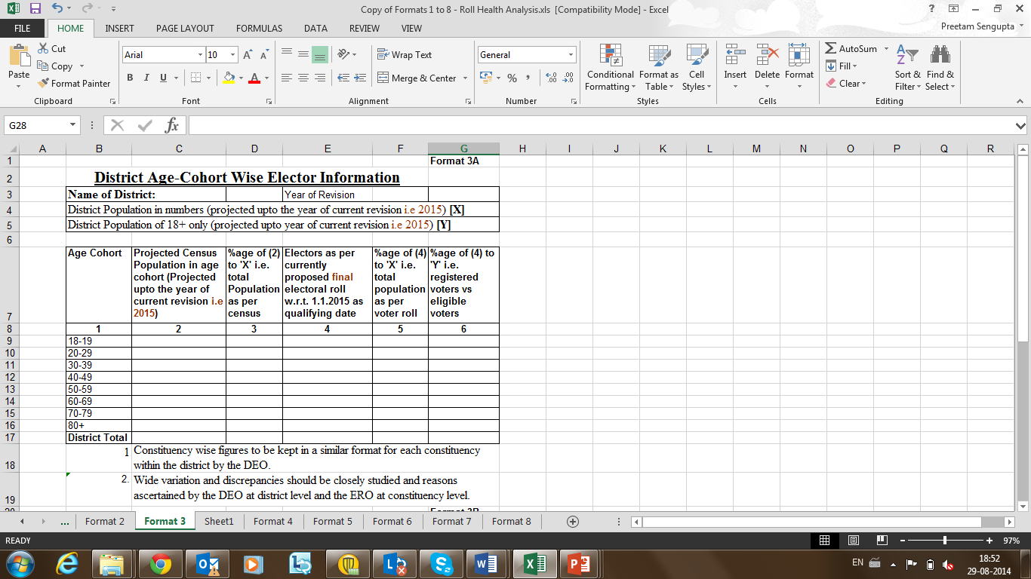
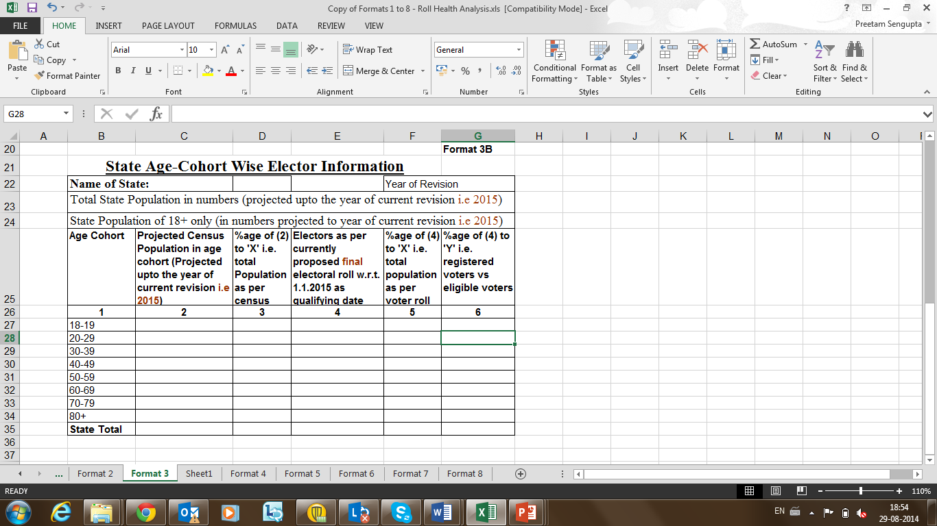
FORMAT 3
Age-Cohort wise
Elector
Information
HEALTH
ANALYSIS

Slide 26
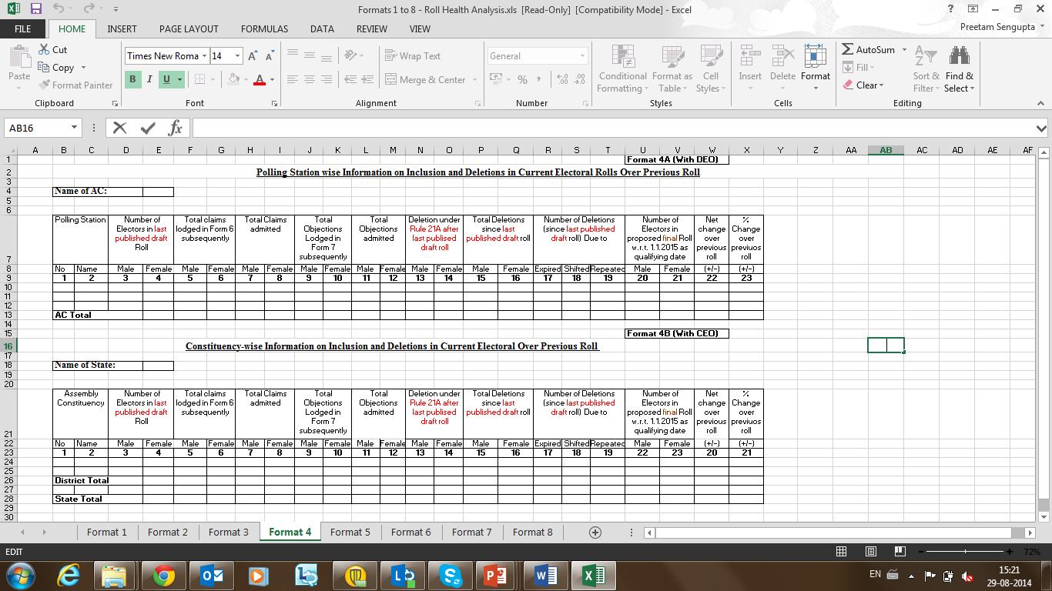
HEALTH
ANALYSIS
FORMAT 4
Information about
Inclusion & Deletions
in the Current Roll
over Previous Roll

Slide 27
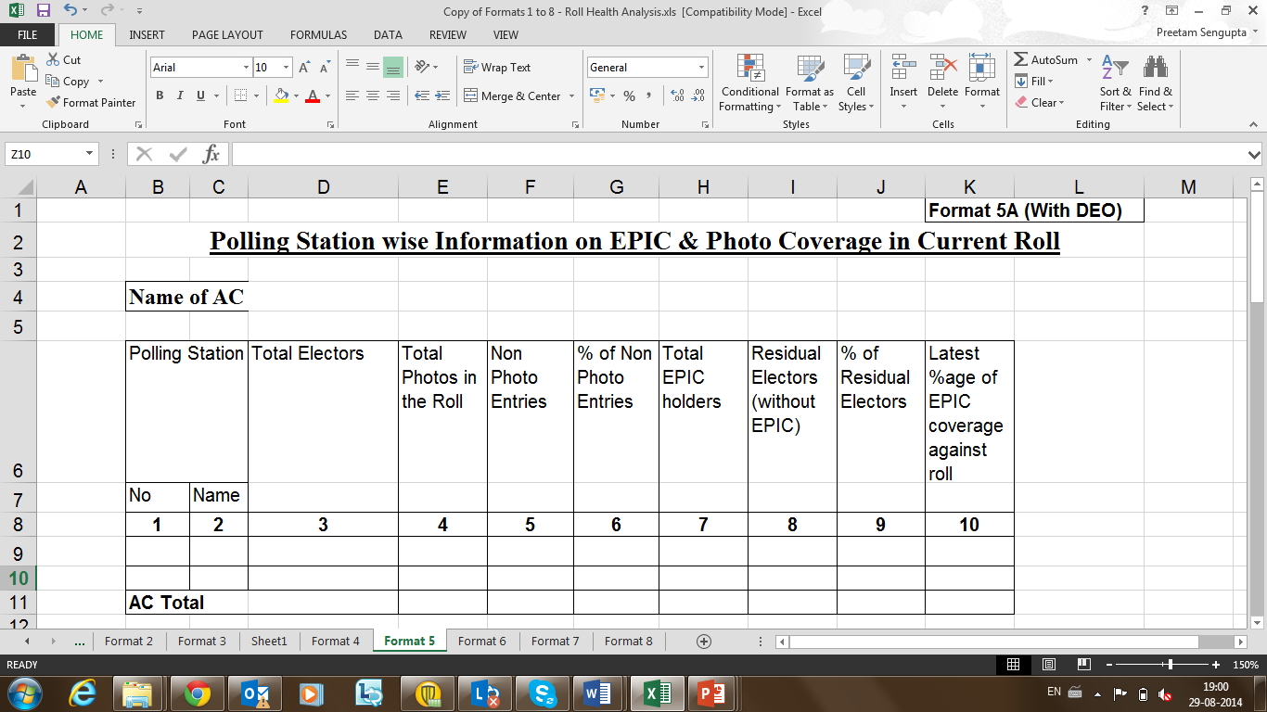
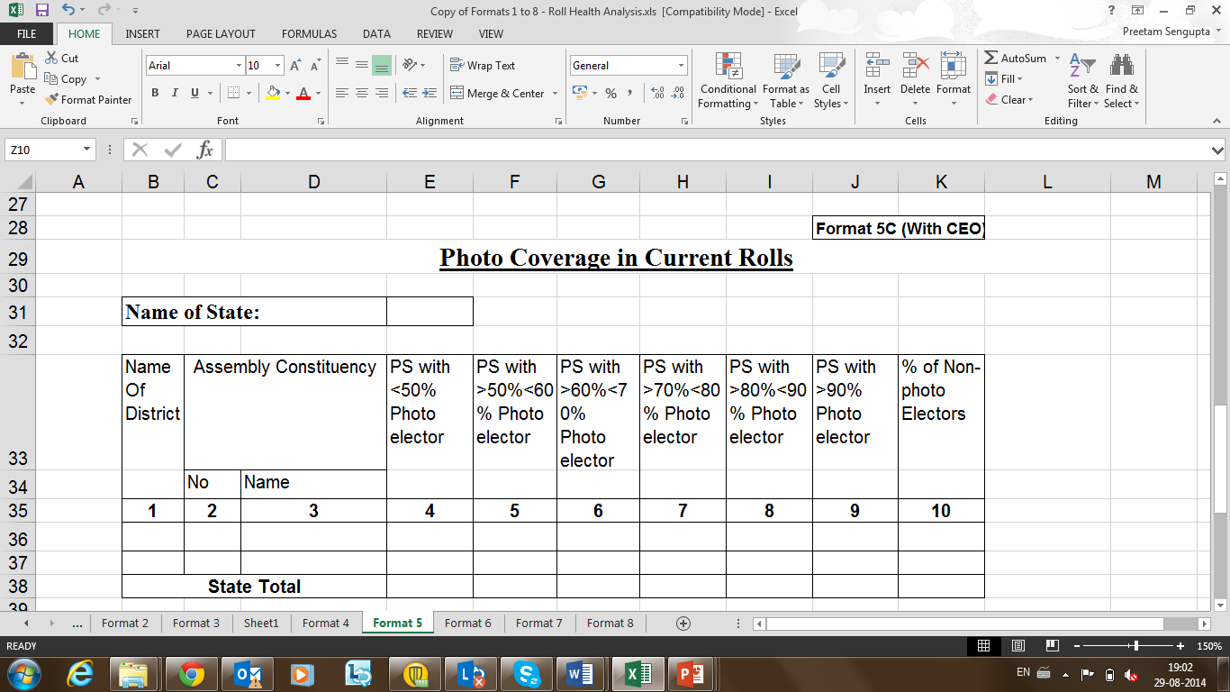
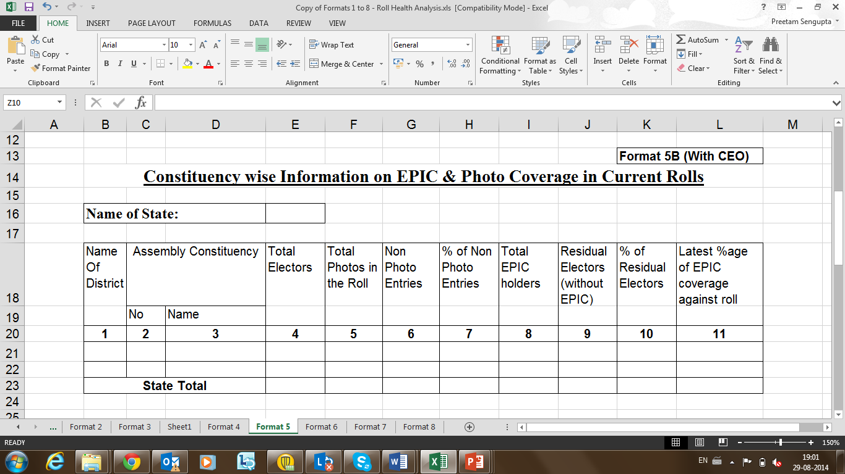
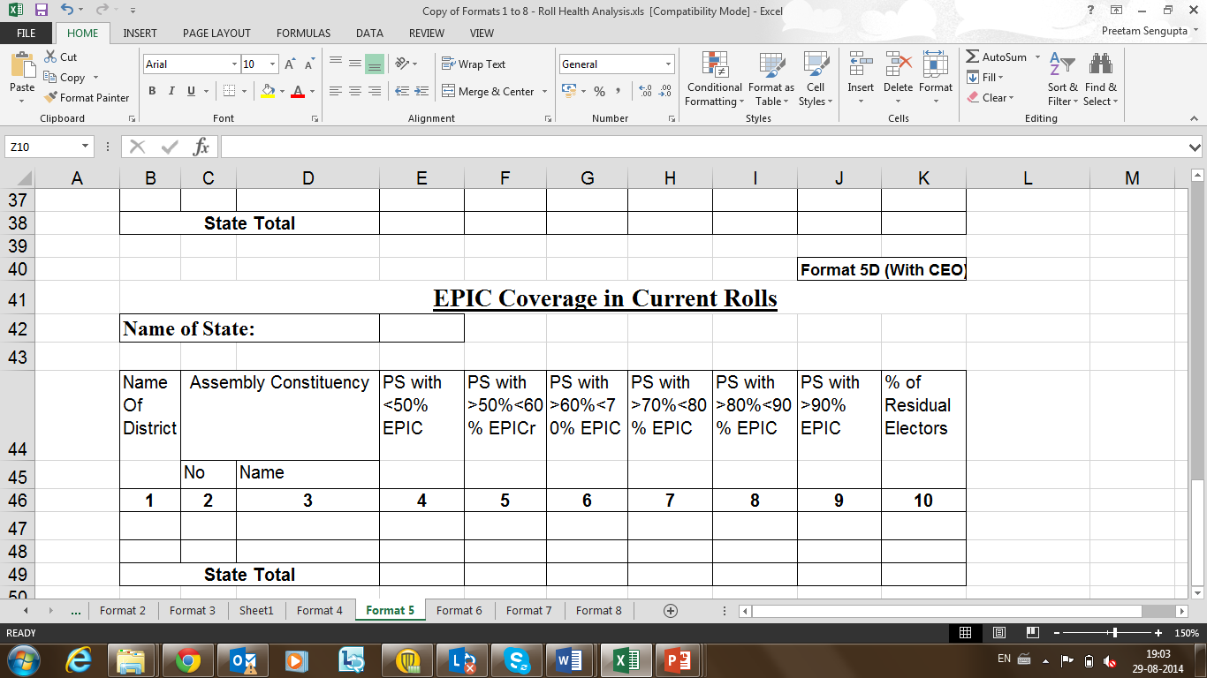
HEALTH
ANALYSIS
FORMAT 5
Photo
& EPIC
Coverage

Slide 28
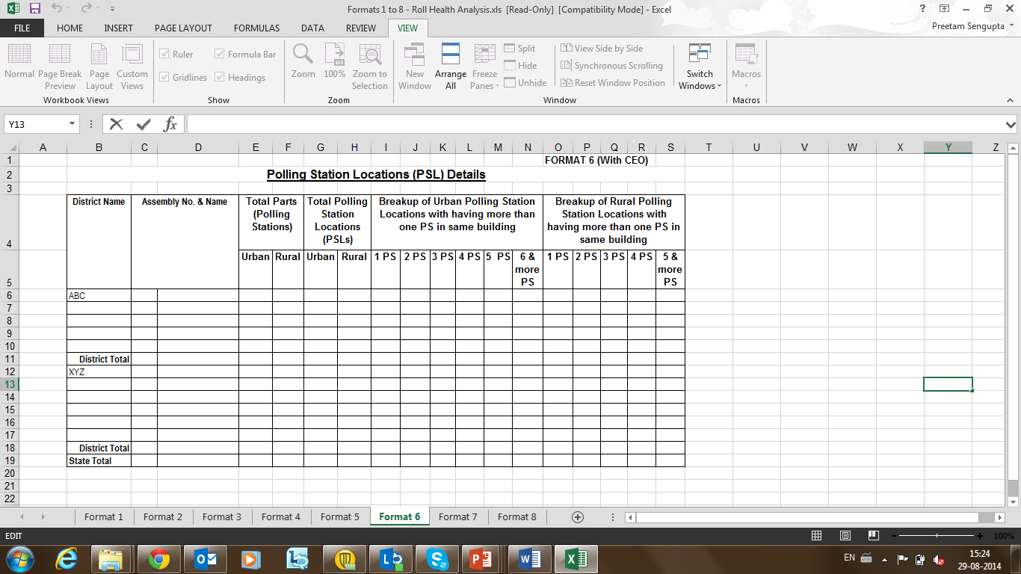
HEALTH
ANALYSIS
FORMAT 6
PSL
Details

Slide 29
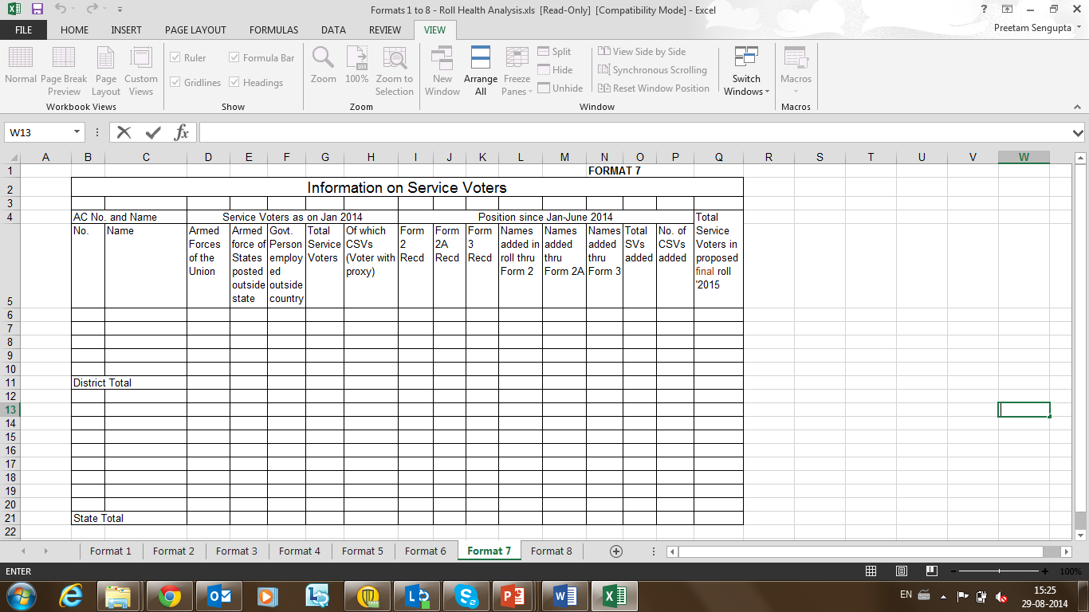
HEALTH
ANALYSIS
FORMAT 7
Information
about
Service Voters

Slide 30
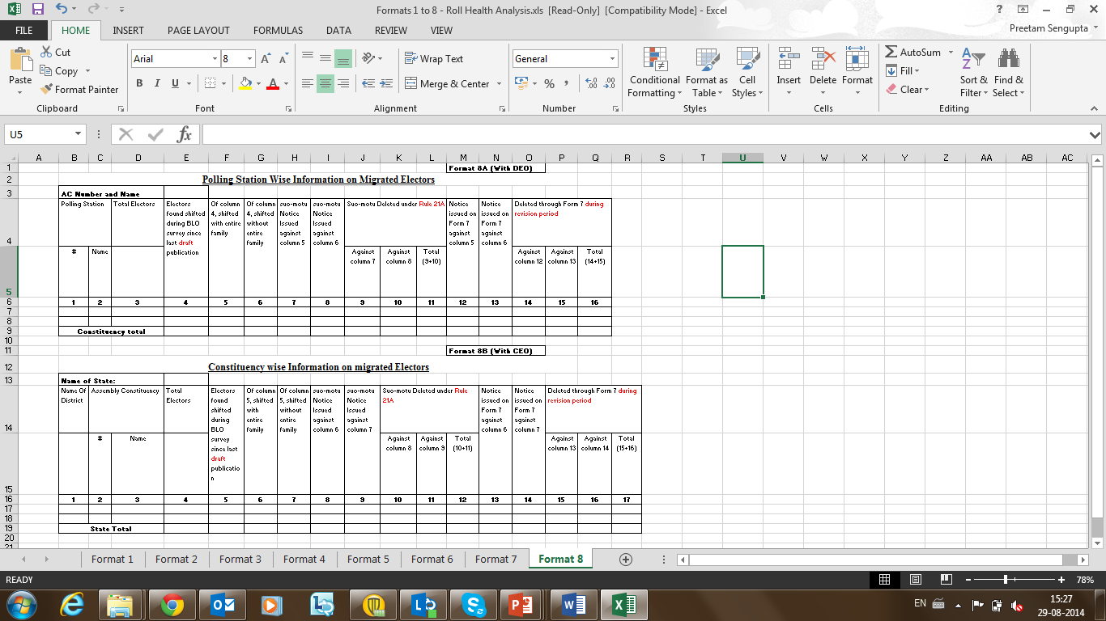
HEALTH
ANALYSIS
FORMAT 8
Information
about
Migrated
Electors

Slide 31
HEALTH ANALYSIS of Rolls
Each ERO should analyse the following types of points using the filled-in formats for the E-Roll of his AC during the training itself:
    How does the Gender Ratio of the AC compare with that of the district, state and the country. Which PSs within the AC have wide divergence from the AC average. Find reasons for wide differences and deviations, if any.
    Is the percentage of any age-cohort much higher/ lower than expected. Compare with fellow trainees. Track deviations.
    Track the working age population for migration, young women for marriage, transgender etc.
    Track senior citizens for being alive.
    Ensure that no enrolled voter of the 18-20 age group is actually underage.
    Any other points of analysis.

Slide 32

DE-DUPLICATION OF VOTERS

Slide 33
DE-DUPLICATION OF VOTERS (1)
Under Sections 17 & 18 of the RPA, 1950, NO PERSON IS ENTITLED TO BE REGISTERED in more than one constituency and for any constituency MORE THAN ONCE. Therefore, the exercise of de-duplication MUST be undertaken.
The de-duplication exercise should be undertaken SUO-MOTU by the ERO before the draft roll is published for summary revision, as a part of the PRE-REVISION ACTIVITIES.
The SOFTWARE FOR COMPUTERIZED DE-DUPLICATION SHOULD BE RUN on the e-roll database for generating THE LIST OF PROBABLE DUPLICATES.

Slide 34
DE-DUPLICATION OF VOTERS (2)
The entries in this list of probable duplicates should then be examined and thoroughly investigated. The repeated names in the electoral rolls should be issued NOTICES UNDER SECTION 22 OF RP ACT, 1950 AND FULL PROCEDURE OF VERIFICATION OF FACTS should be followed.
IF THE NAME ACTUALLY HAPPENS TO BE DOUBLY APPEARING, THEN THE PERSON’S NAME SHOULD BE RETAINED ONLY AT ONE LOCATION WHERE HE/SHE IS ORDINARILY RESIDING (IN CONSULTATION WITH HIM/HER) AND DELETED FROM THE OTHER LOCATION.
Such deletions would form part of the supplement (of deletions) of continuous updation and should form part of the draft publication of rolls under summary revision, in case the draft roll is not an integrated one.

Slide 35
DE-DUPLICATION OF VOTERS (3)
AREAs across which to de-duplicate:
  ERO should do de-duplication across his ENTIRE AC between different parts, as well as WITHIN EACH PART AREA of his AC.
  Each DEO should also get de-duplication done across his entire district. He may specifically FOCUS ON CERTAIN AREAS more prone to duplicate entries such as part AREAS ON BORDERS of ACs, areas having MIGRANT POPULATION or areas having a larger PRESENCE OF CRIMINAL ELEMENTS etc.
  Similarly, the CEO may get de-duplication done for the e-rolls across an entire state or UT. He may also focus on certain specific or risk areas such as RE-SETTLEMENT COLONIES AND PROJECT-AFFECTED AREAS, BORDER areas across districts etc. He may also coordinate with other CEOs for undertaking de-duplication over border areas of neighbouring states/ UTs.

Slide 36
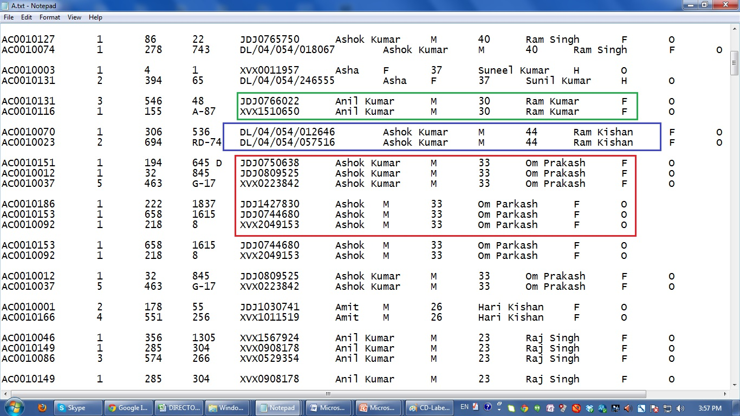
REPORT OF DE-DUPLICATION S/W
(SAMPLE SCREENSHOT)

Slide 37
RUNNING THE DE-DUPLICATION S/W
What the software does
THIS SLIDE IS ONLY FOR TECHNICAL IT PERSONS HANDLING DE-DUPLICATION S/W.
INTERESTED OFFICERS MAY GO THROUGH IT TO ENSURE PROPER DE-DUPLICATION.
Inputs to the program are tab separated voter record files, one line per record, one file per part.
Merge the above files and group them by first character of voter names. This creates 26 files – named A to Z.
If the count of voters to compare is large, split and group each of the above 26 to further 26 each files, based on the first character of relative names. This gives 676 files - named AA, AB … to ZY, ZZ. This second level of splitting is not necessary if the voter count is less than 1 crore.
Read each of the re-organised files. Create a key for a record based on the name, age, sex, and relative name. Metaphone codes are used for the names so that minor variations in spelling (except the first characters) are ignored. This is faster than Soundex. In a dictionary, group voter records whose keys match.
For each group of voter records, fuzzy compare the voter records. If the match is greater than 90, consider the records to be possible duplicates and write to a file.
The files may be compiled to a single file or organised in any convenient manner.
Records in the output file are grouped by sets of possible duplicate entries, separated by additional line-feeds. As the lines are tab separated, the file can opened with a spreadsheet program.

Slide 38
RUNNING THE DE-DUPLICATION S/W
To run the program
THIS SLIDE IS ONLY FOR TECHNICAL IT PERSONS HANDLING DE-DUPLICATION S/W.
INTERESTED OFFICERS MAY GO THROUGH IT TO ENSURE PROPER DE-DUPLICATION.
Create input files, each line with fields: Part, Section, Serial, House#, EPIC#, Voter Name, Sex, Age, Relative Name, Relation, and Status. The fields are separated by tab character. These files can be generated from database.
Create directory structure as explained in the comments in the source code files.
Run ‘groupREC.py’ followed by ‘getDup.py’
Results are stored in a directory that can be chosen by editing concerned parameters in the source code.
Because they are still under development, the programs are run on IDE and not from command line. Changes to the directory structure are done in the source code file. These can be easily taken out to a configuration file. The code can also be made executable without Python interpreter.
Comparing records held against a key in dictionary is of complexity n². Based on the data, the program may take long to complete. The program prints on screen the time at the end of processing each file. Feedback on files that take unusually longer time to process will help improve the program.
Development Environment
Use 64 bit version of Python 2.7. Later versions of Python do not have some library support.
Install modules fuzzywuzzy and from metaphone.
IDLE, shipped with Python is adequate to run the program.
FTP location for de-duplication s/w
ftp://164.100.34.8 Username : Administrator Password : 12oct@sysnet Folder name : Deduplication (Python)

Slide 39
IDENTIFYING ERRORS
IN THE ROLL

Slide 40
LIST OF POSSIBLE ERRORS IN ROLLS
DETECTABLE THROUGH ERMS APPLICATION S/W & DATABASE
(1)
Voter’s name has junk characters or is blank
Part No. has junk characters or is blank
Serial No. of the Voter has junk characters or is blank
Section No. has junk characters or is blank
House No. has junk characters or is blank
Voter relationship has characters other than M or m (for Mother), F or f (for Father), H or h (for Husband), or O or o (for Other)
Voter Sex has characters other than M (Male), F (Female) or O (Other)
Voter gender is Male (M) but relationship is Husband (H)
Voter’s relative’s name has junk characters or is blank

Slide 41
LIST OF POSSIBLE ERRORS IN ROLLS
DETECTABLE THROUGH ERMS APPLICATION S/W & DATABASE
(2)
EPIC no. has less than 10 characters
Age is less than 18 years or greater than 100 years
Photograph exists but EPIC Card Number is not mentioned in the roll
EPIC Card Number exists but Photograph is not available in the roll
List of Records where EPIC Number is repeating – Case of Duplicate EPIC Number
Voter gender is Female (F) but the relationship mentioned in the roll is ‘Father (F) or Other (O)’ for a voter of age more than 30 years. [This is to help track female voters who may change their residence after marriage].
Voter Status Type is ‘other than N or n (New), E or e (Expired), S or s (Shifted), M or m (Modified), R or r (Repeated)’ or if it is Junk Characters
Sections which have no voters in the roll

Slide 42
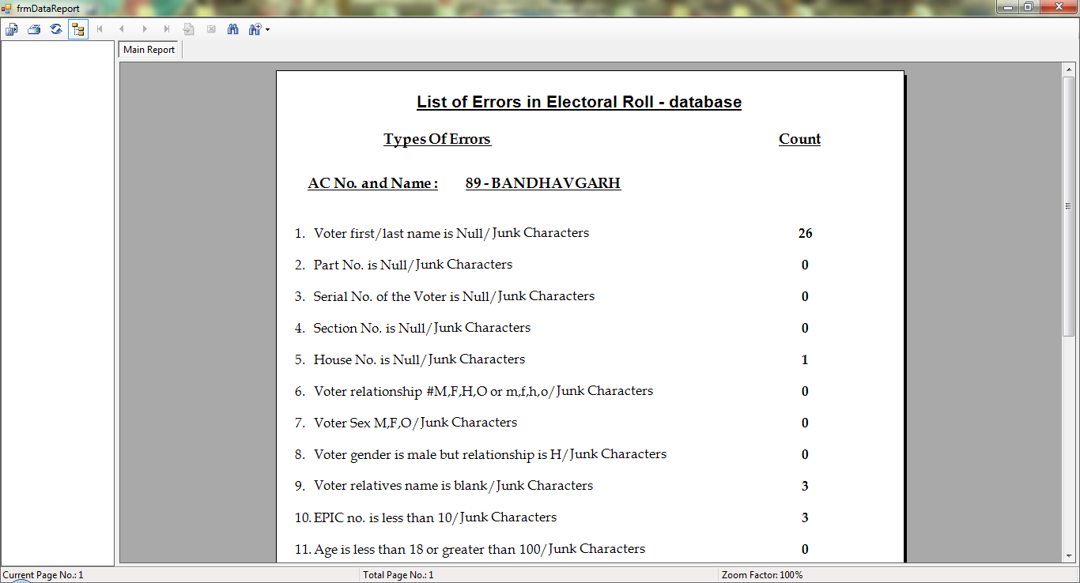
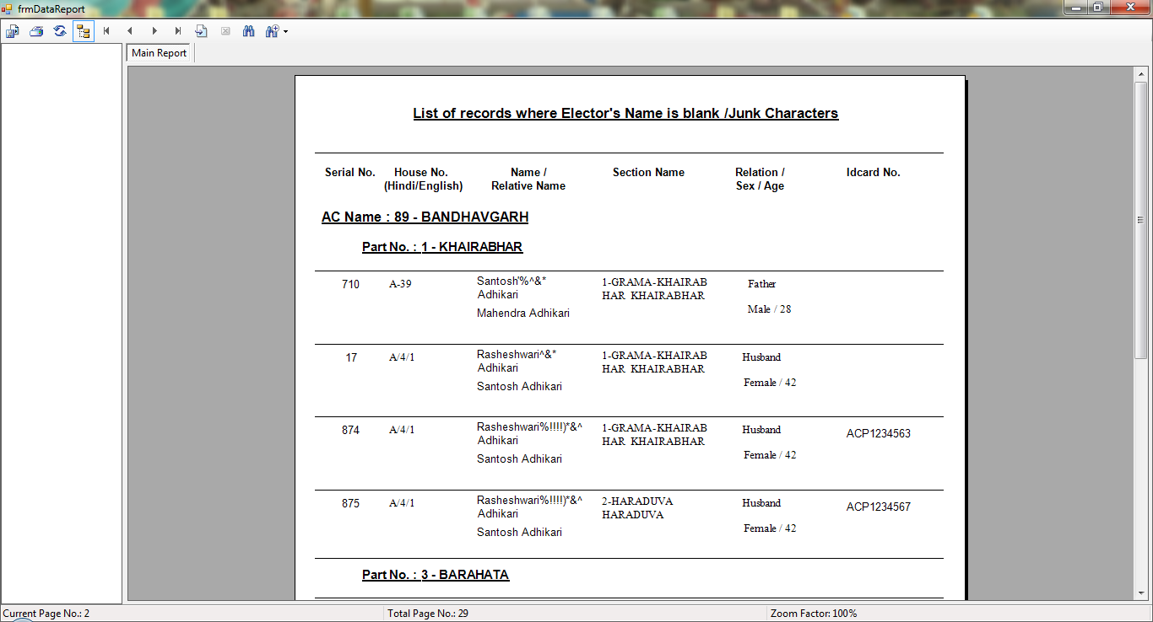
IDENTIFYING ERRORS
IN THE ROLL
If any of these 17 errors exist in the roll, they would appear in the ‘LIST OF ERRORS’ & the ‘PS WISE ERROR REPORT’ which can be generated on computer in the formats shown on the side by using the ERMS software and E-Roll Database.
Each trainee ERO/ AERO should generate these error reports shown on the side for his AC before training, and bring them to the training with himself.
States which do not use ECI’s ERMS application, should develop and use similar applications for this purpose.
If it is not possible to generate these error reports on computer, then EROs should get these errors identified and reports generated through manual inspection of the rolls before training and bring them to the training with themselves.

Slide 43
IDENTIFYING ERRORS
IN THE ROLL
Each trainee ERO/ AERO should carefully see which probable errors have been identified in these reports by the computer.
He should also list any more errors and problems that he may have found in his roll or relating to enrolment in his area over time, during field visits or otherwise.
He should analyse all these errors and problems, and think how he would verify and remove them.

Slide 44
FORMULATING STRATEGY &
PLAN OF ACTION
FOR
IMPROVING THE ROLL
AFTER
HEALTH ANALYSIS &
ERROR IDENTIFICATION
(POA)

Slide 45
FORMULATING STRATEGY & POA
DURING THE TRAINING
(Plan-Of-Action)
After doing Health Analysis & Error Identification, each trainee ERO/ AERO should use these learnings to formulate at least 5 to 10 Points of Strategy & a Plan of Action for Improving the Roll of his PS DURING THE TRAINING ITSELF
He should think of different approaches he will adopt to make his roll accurate, error-free & updated
Trainers, AEROs, EROs & DEOs should help their BLOs make efficient & feasible strategies and plans, and should forward them to their CEOs

Slide 46
FORMULATING STRATEGY & POA
      POINTS TO PONDER
(Plan-Of-Action)
Gender
In-migration/ Out-migration
High death rate
Student population
Change in the boundary of the part areas; New habitations
Industrial labour/ Agricultural Labour
Apartments with access control
Inaccessible areas – deeply forested, river crossing etc.;
Absence of RWAs; Defunct Gram Sabhas…
      Think of more such categories & Action Points for Inclusion and Facilitation

Slide 47
FORMULATING STRATEGY & POA
(Plan-Of-Action)
An exhaustive list of points of Strategy & POA should be drawn for all the problems and issues the trainee ERO/ AERO identified in the previous exercise.
Some illustrative examples could be:
    Gender ratio in my AC is much lesser than that of the district, state or country - I need to check & ensure that all eligible women are enrolled. (Or the opposite of this).
    While travelling in my AC, I noticed that some new colonies have come up – I need to ensure that all the residents (tenants & landlords) are registered.
    A new industrial factory has been set up in my AC – I need to register all the migrant labourers working in the factory.
    Very few trans-genders seem to have got enrolled till now, whereas I keep seeing them quite often while coming to office – I need to ensure that all trans-genders in my AC are enrolled.

Slide 48
FORMULATING STRATEGY & POA
(Plan-Of-Action)
Some more illustrative examples of points for Strategy & POA:
    Inmates of jails, other persons in legal custody, hospitals, beggar homes, asylums etc. may still not be included in the electoral rolls of my AC, though such institutions/ areas are there in my AC.
    Serving members of the Armed Forces of the Union or of the Central Police (Para-Military) Forces are enrolled, if they are native of my AC or want to get enrolled here. Are any of them appointing any ‘proxies’?.

Slide 49
FORMULATING STRATEGY & POA
(Plan-Of-Action)
The trainee ERO has to brainstorm on similar lines (of examples given in the previous slide) & come up with possible solutions for the errors/problems/issues that came up in the health analysis of the roll. They could also include factual cases & solutions based on their field experiences.
Each trainee ERO should think of different approaches they will adopt to make the E-Roll of their part area accurate, error-free & updated.
Trainers/EROs/AEROs should make note of the all strategies formulated for their efficiency & feasibility & forward them to their respective DEOs & CEOs.

Slide 50
FORMULATING STRATEGY & POA
(Plan-Of-Action)
See the Points of Health Analysis & the Details of Identifiable Errors discussed in the foregoing slides to further strengthen your Points of Strategy & Plan of Action

Slide 51
TRAINING The BLOs

Slide 52
WHY TRAIN THE BLOS
  BLO is the cutting edge of e-roll administration.
  He is the face of the Commission who actually contacts the voters.
  The quality of BLO’s performance has direct bearing on the quality and accuracy of the roll, and thereby on the integrity of any election as well as on stakeholder satisfaction.
INCLUDE THESE IN BLO TRAININGS
    Motivate your BLOs
    Discuss the importance of the pre-revision & revision processes & their impact on the accuracy & quality of E-Rolls
    Health analysis of part-area rolls & error/problem identification in the particular rolls of their respective PSs
    How can BLOs make their field visits more productive
    Matters of Inclusion & Facilitation
    importance of Procedural & Legal discipline
  HOLD YOUR BLO TRAININGS IN 3 SESSIONS SPANNING AROUND 300 MINUTES

Slide 53
BLO TRAINING – FIRST SESSION
CONTENTS
  Motivation
  Discussion on the
    The IMPORTANCE of the Roll
    The IMPORTANCE of Accuracy and Quality in the Roll
    The IMPORTANCE of Summary Revision as an Opportunity for making the Rolls Accurate and of high Quality
    The IMPORTANCE of the role of the BLOs in Summary Revision
  Discuss the responsibilities and mandates of BLOs, and their position in the electoral hierarchy and related aspects. For example, enrolment of electors, roll management process, structure of the roll, familiarising with constituency parts and sections, pre revision activities like verification and rationalisation, EPIC etc.
  A mock Map-Making Exercise can be carried out in this session.
  End the session by recapitulating the lessons learned.
OUTCOME
  BLOs are motivated towards their assignment & comprehend their role & duties in maintaining the health of an Electoral Roll.
METHODS
  Brainstorm, Ice Breaker, Presentation cum discussion, Quiz

Slide 54
BLO TRAINING – SECOND SESSION
  Deal with broadly the issues & challenges related to revision of electoral rolls & types of revision.
  Discuss the tendency towards non-inclusion of certain categories like women, third gender, college students & deliberate on ways to increase their enrolment.
  Discuss at length on the various statutory Forms & the information that needs to be filled in them, BLO kit, verification of E-Rolls, & ways to make field visits more firmly productive & efficient.
  Carry out a Mock Exercise of filling up of statutory Forms. For that the ERO should ensure:
      that all the BLOs bring their kits to the training, along with blank copies of all Forms (6, 6A, 7, 8, 8A). (If BLOs don’t have Forms, then the ERO shall provide blank forms to the BLOs at the time of training).
      each trainee BLO should take one form of each type and cancel them at the start by writing the words ‘Dummy & Cancelled’ across them (so that they do not mix up with actual forms at any time).
      BLOs should fill one form of each type with dummy data/ information in front of the ERO
      any uncertainty/query/doubt should be addressed by the ERO, thereby ensuring that the BLOs are thorough about how these forms are to be filled.
      destroy the forms at the end of training.
  End the session by recapitulating the lessons learned.

Slide 55
BLO TRAINING – THIRD SESSION
This session is intended to further reinforce the lessons learnt in session one & two.
Reinforce the importance of procedural & legal discipline to BLOs with examples and illustrations.
MOST IMPORTANT EXERCISE OF THE TRAINING
Just like the EROs, the trainee BLOs also have to ANALYSE THE HEALTH & IDENTIFY ERRORS IN THE PARTICULAR ROLLS OF THEIR ASSIGNED POLLING STATIONS.
RESULTING IN FORMULATING AT LEAST 5 TO 10 POINTS OF STRATEGY AND PLAN OF ACTION to remove errors & improve quality of their rolls.
Related Case Studies & FAQs to be discussed.
Recapitulate the lessons learned during the entire training program.
END-OF-TRAINING EVALUATION. Carry out the End-of-Training test. Get answer sheets exchanged amongst participants for peer evaluation. Discuss the correct answer to each question one by one. Each trainee needs to secure minimum 50% marks in this evaluation.

Slide 56
RECAPITUALTE
Motivation & Importance
Health Analysis Of The Roll
De-duplication of Voters
Identifying Errors in the Roll
Formulating Strategy & Plan of Action for Improving the Roll
Training The BLOs

Slide 57
THANK YOU
Disclaimer:
This training material is for use in training of election officials. It should not be referred as guidelines of ECI. In case of any variance in this training material and ECI guidelines/ rules/ laws, the ECI guidelines/ rules/ laws shall prevail.

